Slide 1
Community-centric analysis of user engagement in Skype social network
Giulio Rossetti*, Luca Pappalardo*, Riivo Kikas’, Dino Pedreschi*, Fosca Giannotti*, Marlon Dumas’
* University of Pisa, ISTI-CNR ‘ University of Tartu
ASONAM 2015, Paris

Slide 2
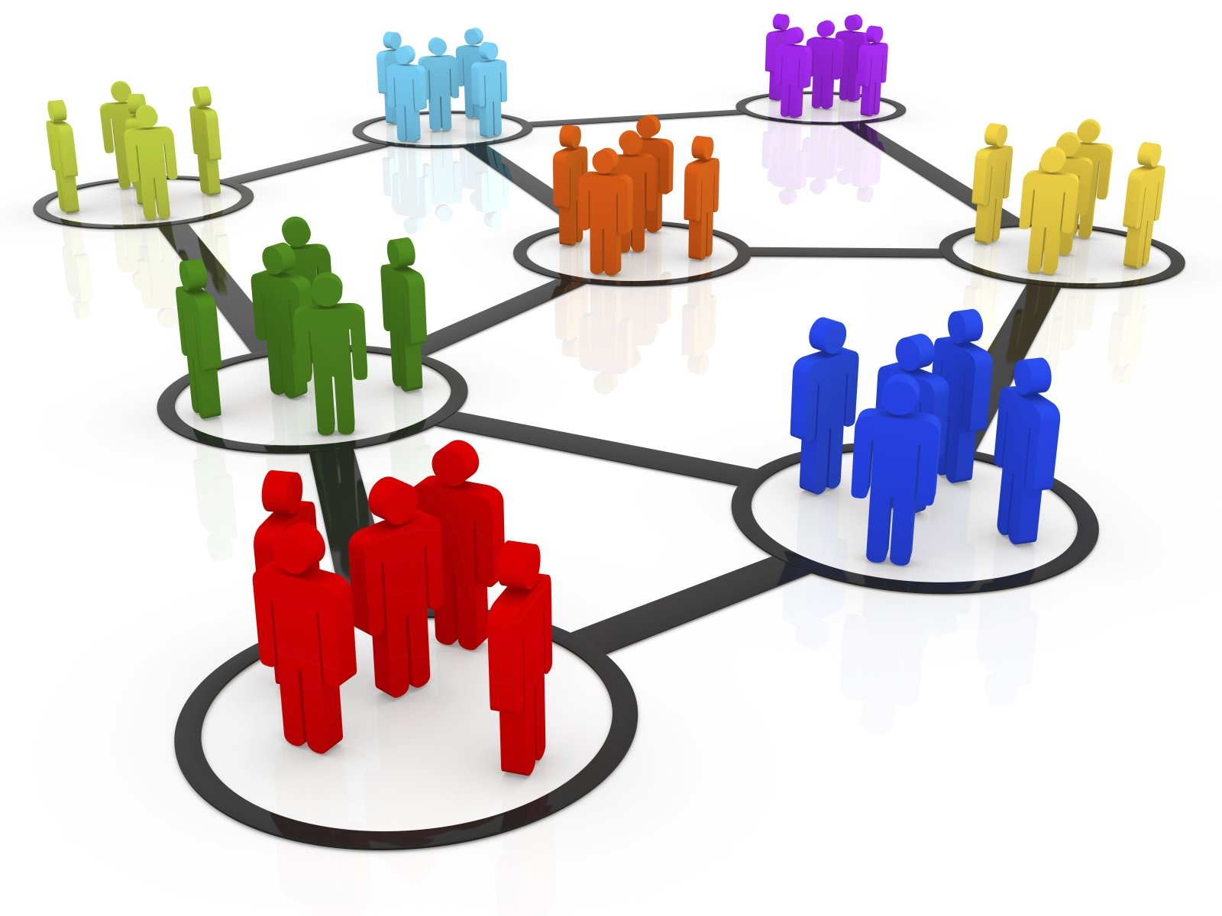
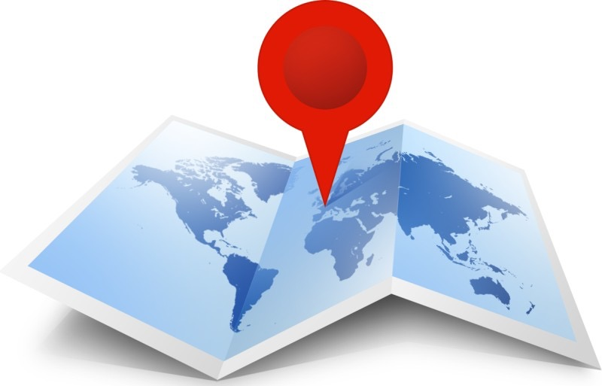
Skype Data: a first glance
Semantic rich dataset:
Social Graph (built upon users contact lists ~billions of nodes)
Users Geographic presence (city, nation…)
Users Monthly Activity (individual’s days of Audio\Video\Chat products usage)

Slide 3
Problem: Service Usage
Given an online platform we often we need to estimate how its services (i.e., Skype Audio\Video call) are used by the registered users. In particular we can be asked to answer the following questions:
Q1: Can Service Usage be described as a function of the Network Data?
Q2: If so, at which scale should we analyze the network in order to perform a descriptive analysis?

Slide 4
Analysis Workflow
We designed an experiment whose aim is to provide an intuition on how to extract meaningful knowledge regarding the usage of the Skype services. It can be decomposed in 3 phases:
Identify a meaningful network partition (scale);
Extract, for each subnetwork, a set of topological (and geographical) attributes;
Build a classifier over such attributes and evaluate its performances when used to discriminate High from Low active communities.

Slide 5
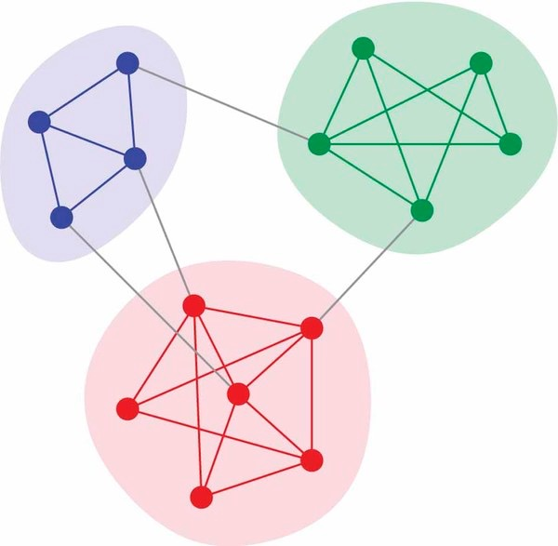
Observation Scale?
Problem: Given the size of the dataset (several hundred millions of users) an individual level analysis can be redundant;
Idea: Homophily has been proven to hold on several social context:
Identifying tight groups of “similar” users we can reduce the problem space
Community Discovery

Slide 6
OK… so, which kind of communities should I use?
Each CD algorithm provides a different perspective on what a community is….
Different definitions (crisp\overlap, modularity\density, size distribution…)
Different network partitions
We evaluate our approach using:
HDemon
Louvain
Ego-Networks
BFS

Slide 7
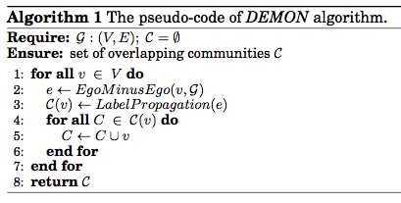
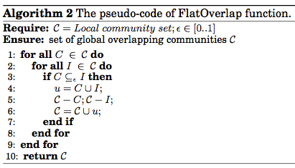
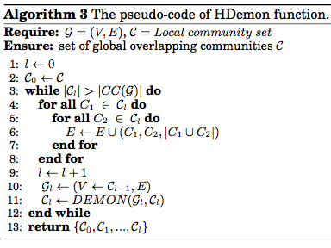
Demon & HDemon in a nutshell
Social Networks are Complex Objects
Can we make them “simpler”?
Ego-Networks
(i.e., networks builded upon a focal node , the "ego”, and the nodes to whom ego is directly connected to plus the ties, if any, among the alters)
Two steps process:
Micro communities extraction (i.e., denser areas within ego networks - Label Propagation)
Aggregation of “similar” communities
Multiple Merging Strategies
M. Coscia, G. Rossetti, F. Giannotti, D. Pedreschi DEMON: a Local-First Discovery Method for Overlapping Communities ACM SIGKDD KDD 2012
M. Coscia, G. Rossetti, F. Giannotti, D. Pedreschi Uncovering Hierarchical and Overlapping Communities with a Local-First Approach. TKDD, 2014.

Slide 8
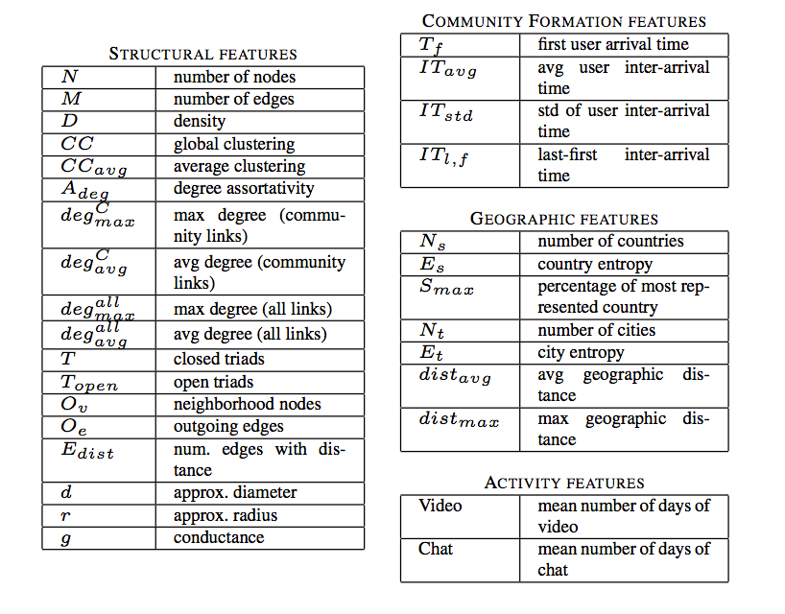
SGD classifier features
For each network partition obtained, we built Stochastic Gradient Descent classifier and trained it to discriminate between High and Low active communities.

Slide 9
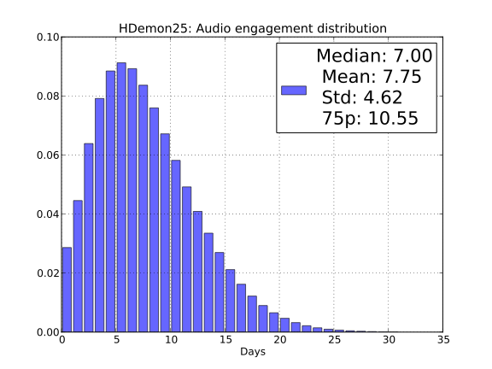
Target Class
The target class identify the Service Activity Level (High/Low)
Two scenarios:
Low/High activity is identified by the median of the distribution (i.e., an highly active community have and avg activity > than the median of the overall activity distribution)
High activity communities are the one above the 75th percentile

Slide 10
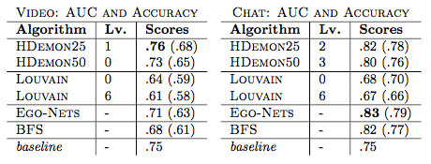
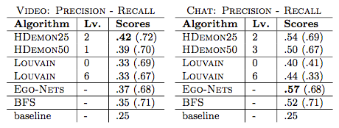
Results
Balanced scenario
75th percentile scenario
In the 75h percentile scenario due to the hard baseline we also evaluate precision and recall over the minority class (i.e., High activity)
In both scenarios we are able to better characterize communities activity level using HDemon and Ego-Networks.

Slide 11
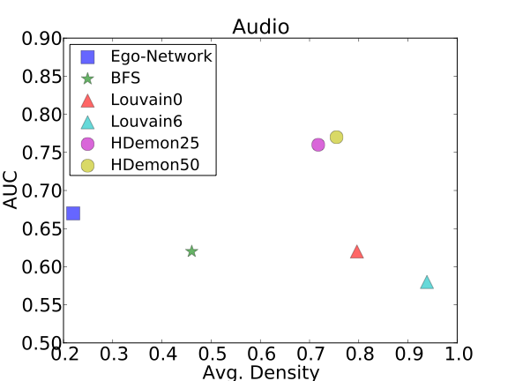
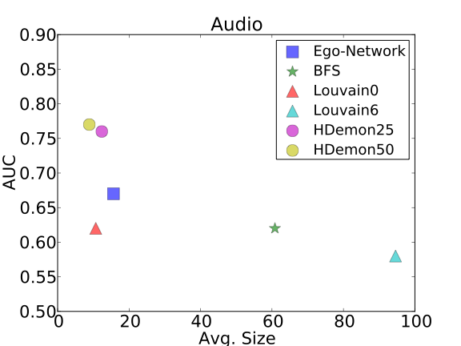
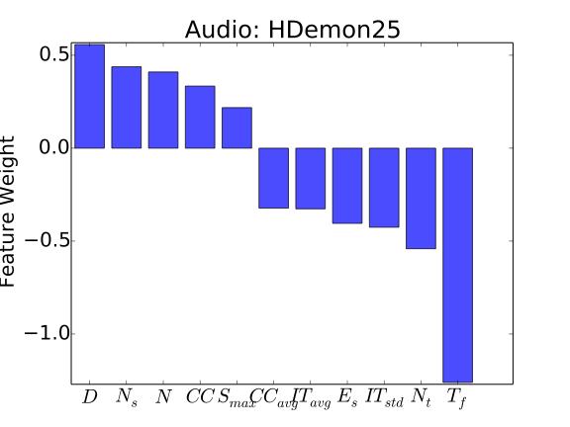
Community Description
HDemon and Ego-Networks produce smaller and denser communities.
Looking at the weight assigned to each feature we can identify some common characteristics of Highly active communities (e.g., for Audio\Chat, low clustering coefficient, reduced size, geographical compactness)

Slide 12
Conclusion
Subgraph topologies, along with simple temporal and geographic features, can be used to infer service usage
Smaller and denser communities better bound homophilic behaviors
Geo-entropy can be used yo get a preliminary insight on the kind of product we can expect as highly used within a specific community:
High entropy -> probable High Video
Low entropy -> probable High Audio/Chat

Slide 13
Any questions?
Thank you for your attention!

